Slide 1


Kelvindale Primary School PTA
Welcome & Information Pack

Slide 2
A Warm Welcome To Your PTA
We are delighted to welcome all parents, carers and friends of Kelvindale Primary.
Our PTA works together with the school community to support learning, activities and events.

Slide 3
About the PTA
Why does the school have a PTA?
Strengthen links between school and home.
• Organise fundraising events is to support the school by raising as much money as we can to enhance, enrich and improve learning experiences for the children.
• Support school trips and resources
• Build a strong community spirit - to bring the communities of school and home closer together because it makes sense for parents to be involved in the life of their chosen school.

Slide 4
About the PTA
Why does the school have a PTA?
• Lastly, we’re here for the simple reason that we want to get together socially, meet new people and have fun!
The PTA is run by a committee who are all volunteers. We might sound like an abstract group of people, but we're parents, carers, friends and allies – just like you. Not so long ago, we were new too.

Slide 5
We always try to respond when asked to help the school and after the work is done. It is so rewarding to see the children enjoy new resources and equipment provided by the PTA. memorable, such as [insert some of the things you’ve provided here]. Sometimes we hold free events to say thank you for supporting us.
Our Achievements
Main Events Held:
Meet the teacher night | Halloween
Sports Day Coffee Stall | Winter Fair
Class Fundraising | Summer Fair

Slide 6
extras' that make school memorable, such as [insert some of the things you’ve provided here]. Sometimes we hold free events to say thank you for supporting us.
Our Achievements
Some examples of what the PTA funded with the money
What Did We Buy? | Who For? | What were the Benefits?
Playground Equipment | All the children | Keep the children healthy, promoting social interaction, developing self-confidence
Sports equipment, football trophies
Books, stationary
STEM resource‘s
Clyde in the Classroom
Supporting school trips
Providing Primary 7 Leaving Hoodies
Christmas Panto

Slide 7
extras' that make school memorable, such as [insert some of the things you’ve provided here]. Sometimes we hold free events to say thank you for supporting us.
What the PTA funded with the money
The School Requests benefits all year groups and over £5,000 of school requests were funded by KPS PTA within the last year.

Slide 8
extras' that make school memorable, such as [insert some of the things you’ve provided here]. Sometimes we hold free events to say thank you for supporting us.
How we keep you up-to-date with our activities?
Socials groups | Example: We post notices about all upcoming meetings on our socials group as well as reminders about events and requests for volunteers.
Book bags | Example: We put flyers, sponsor forms and notices in book bags.
Newsletter | Example: We hope to generate a newsletter once a term which can put into book bags and on the PTA noticeboard.
Online Communication tool | Example: We post notices about all upcoming meetings and via the school email as well as reminders about events and requests for volunteers.
Noticeboard | Example: The PTA noticeboard in the school is updated regularly to keep our community updated and informed.

Slide 9
How can you get involved?
We always welcome new members and volunteers!
The more people become involved, the more we can achieve and the easier it will be.
Ways to get involved:
• Attend meetings
• Volunteer at events
• Share your ideas and skills
Even if you have younger children at home, or only a small amount of time, could you come to a meeting, help set up an event, serve food or design a poster?
Perhaps you have a professional skill you could help us out with?
You don't have to come into the school; many of our volunteering tasks can be done from home.

Slide 10
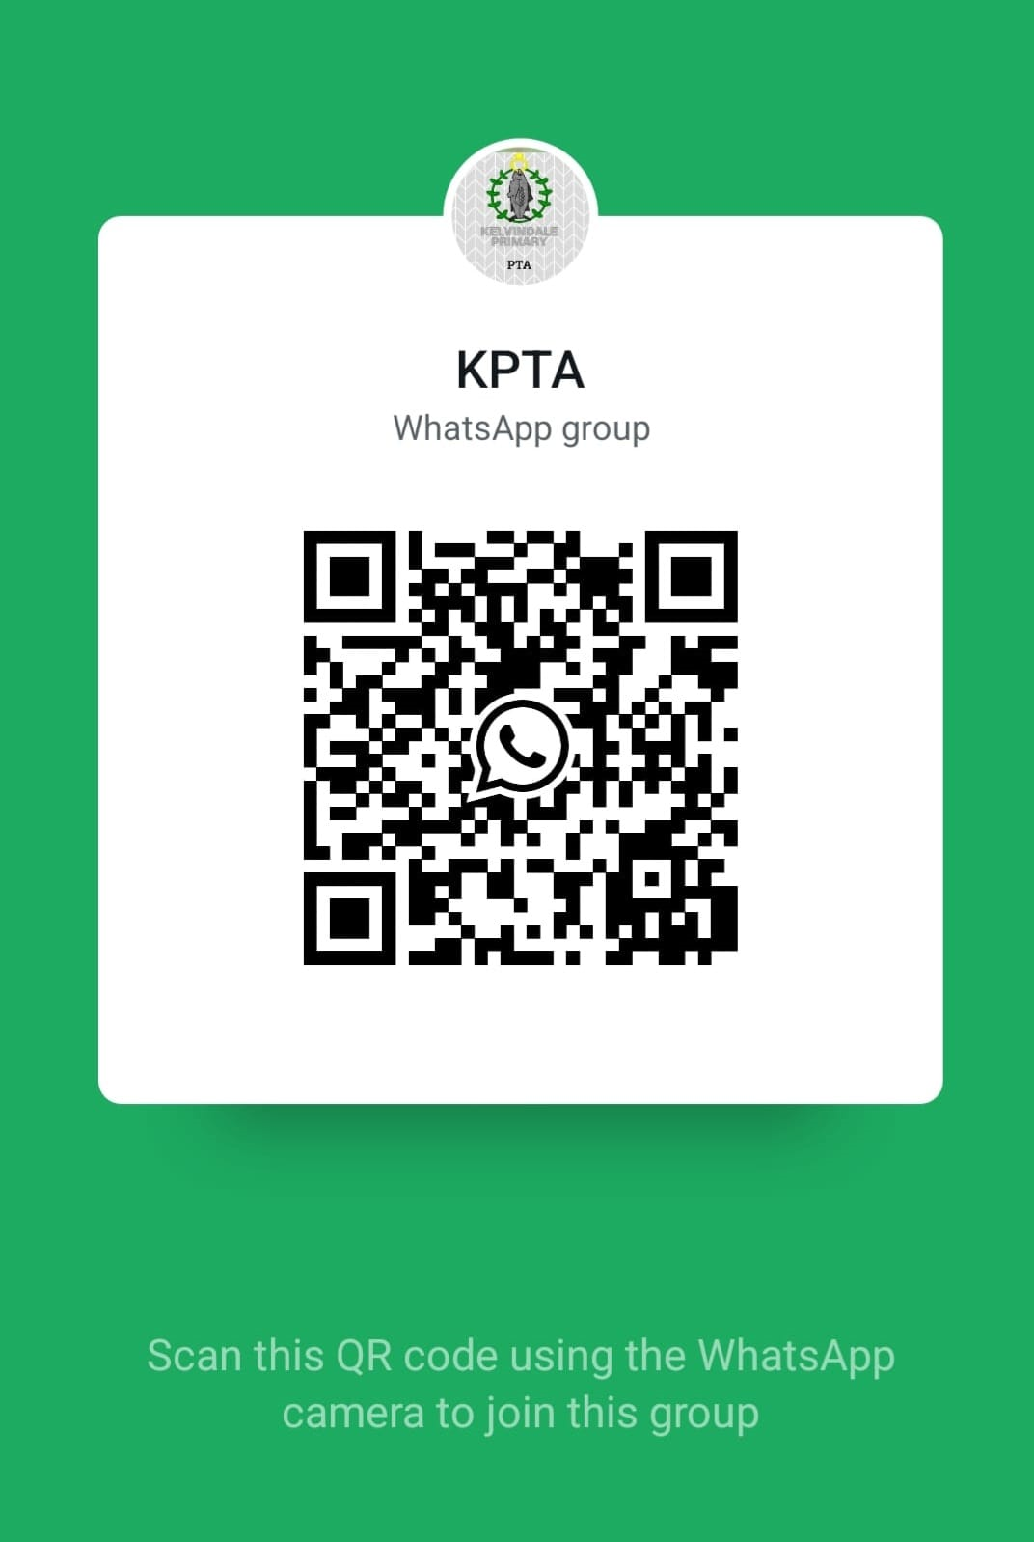
Contact Us
We'd love to hear from you!
Kelvindale Primary School PTA
11 Dorchester Place
Glasgow
G12 0BP
📧 Email: kelvindalepta@yahoo.com
Socials:
🌐 https://www.facebook.com/KelvindalePTA
💬 WhatsApp: Scan QR code to join

